Slide 1

Project Title
Superstore Sales Analysis and Forecast

Slide 2
Project Goal
The primary objective of this project is to analyze historical Superstore sales data (2018–2021) to:
Understand overall business performance and growth trends
Identify key sales drivers across time, region, customer, and product dimensions
Detect loss-making products and optimization opportunities
Forecast next year’s sales using data-driven methods
Deliver actionable insights for strategic decision-making

Slide 3
PESTEL Analysis
Political
Retail sales are influenced by regional tax structures, trade regulations, and interstate commerce policies. A stable political environment supports long-term operational planning and store expansion.
Technological
Advanced analytics and visualization tools enable real-time performance monitoring and forecasting. Data-driven decision-making improves pricing, inventory planning, and demand prediction.
Economic
Macroeconomic factors such as inflation, consumer purchasing power, and economic recovery cycles directly impact sales volume. The observed post-2019 recovery suggests resilience and growth potential under stable economic conditions.
Environmental
Growing awareness of sustainability impacts packaging, logistics, and supplier choices. Operational efficiency can reduce both environmental footprint and cost.
Social
Changing consumer behavior, increased online purchasing, and demand for fast delivery affect product mix and sales strategy. A high proportion of repeat customers indicates strong brand loyalty and customer satisfaction.
Legal
Compliance with consumer protection laws, pricing transparency, and return policies is essential. Accurate reporting and discount management reduce legal and reputational risks.

Slide 4
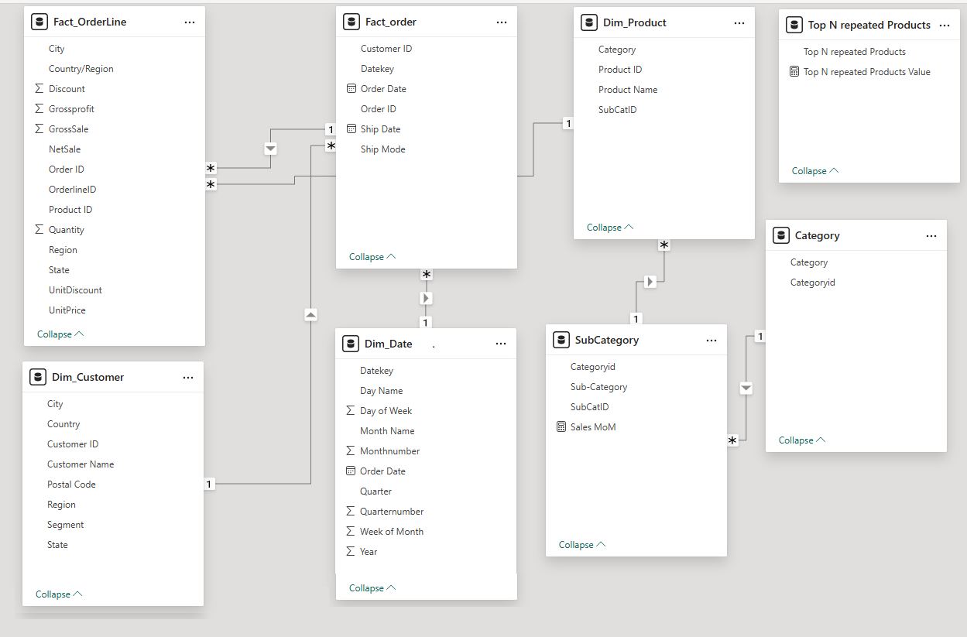

Slide 5
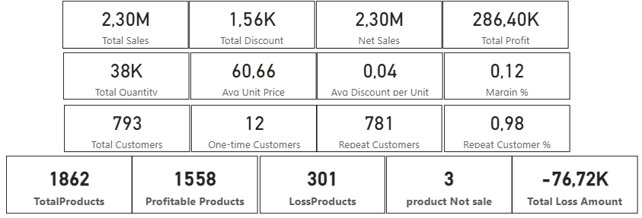
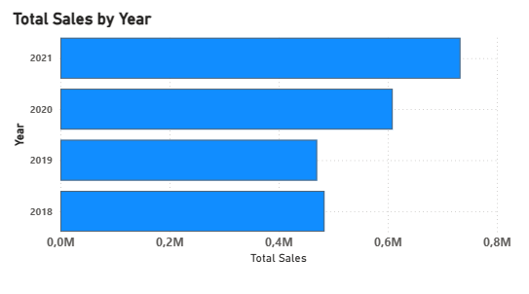
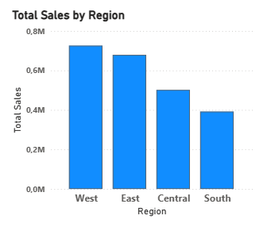
Executive overview
Business performance shows a strong recovery and growth trend.
Total sales reached 2.30M with a net profit of 286K, driven primarily by repeat customers (98%) and strong performance in the West and
East regions.
Sales declined in 2019 but recovered significantly in 2020 and peaked in 2021, indicating a resilient and scalable business model.
However, 301 products are loss-making, generating a total loss of 76.7K, highlighting the need for product and pricing optimization.
Overall, the business demonstrates solid growth potential, with clear opportunities to improve profitability by addressing underperforming products and focusing on high-performing regions.

Slide 6
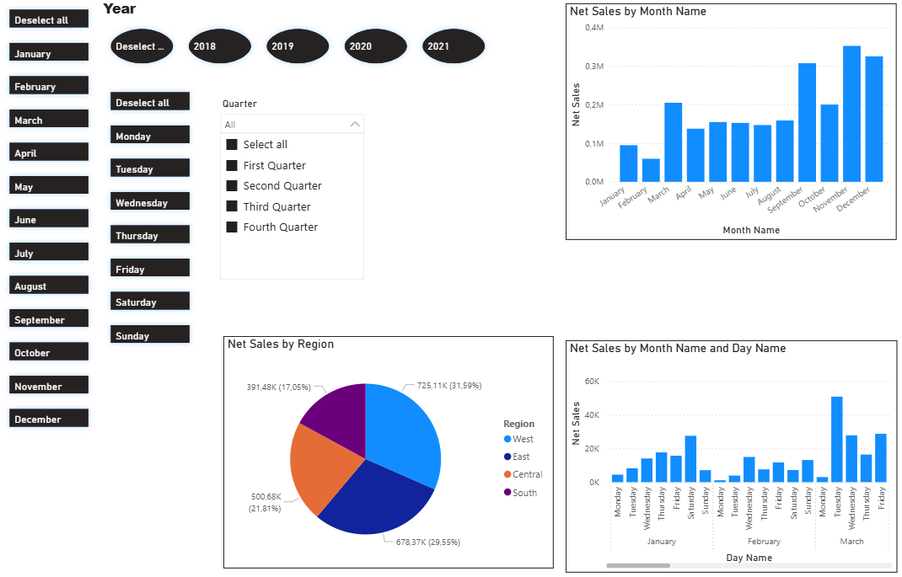
Sales Performance
Time-Based Sales Performance Overview
This page provides a comprehensive time-based sales analysis, covering yearly, quarterly, monthly, and day-level performance to identify trends, seasonality, and demand patterns.
At the year level, sales demonstrate a consistent upward trend, reflecting overall business growth and improved performance over time. Quarter-wise analysis highlights stronger results in the second half of the year, with Q4 emerging as the peak revenue period, driven by higher customer demand and seasonal buying behavior.
On a monthly basis, sales remain relatively stable in mid-year but increase sharply toward October–December, indicating strong year-end momentum. Day-wise analysis reveals that sales are concentrated on weekdays, especially mid-week, suggesting that business demand is primarily driven by operational and corporate purchasing rather than weekend consumer activity.
Overall, this time-based view enables stakeholders to optimize planning, promotions, and resource allocation by aligning strategies with high-performing periods and anticipating future demand patterns.
Sales growth is driven by strong Q4 seasonality and consistent weekday demand patterns.

Slide 7
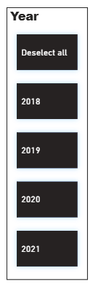
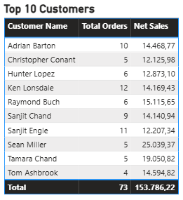
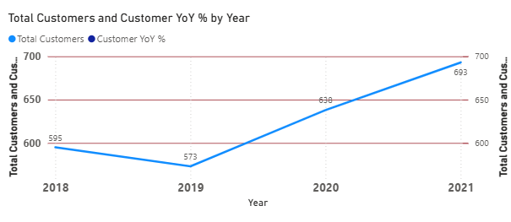
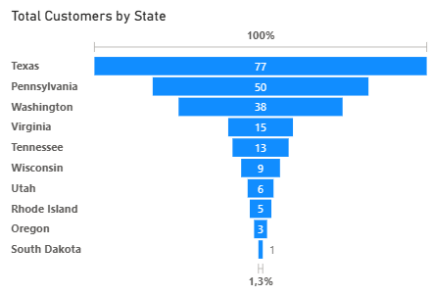

Customer Performance & Retention Overview
This page highlights customer value, geographic distribution, and retention trends. A small group of top customers generates a significant share of sales, indicating strong high-value relationships. Customer presence is concentrated in key states, while several regions remain under-penetrated, offering expansion opportunities. Year-over-year analysis shows steady customer growth after 2019, reflecting improved acquisition and recovery. With a 98% repeat customer rate, retention is a major strength, demonstrating high customer loyalty and long-term business stability.

Slide 8
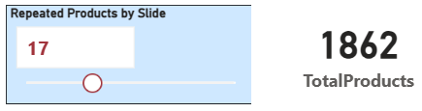
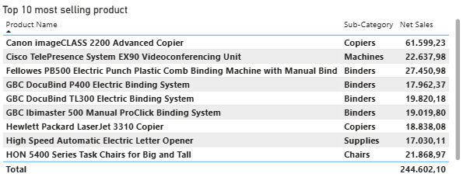
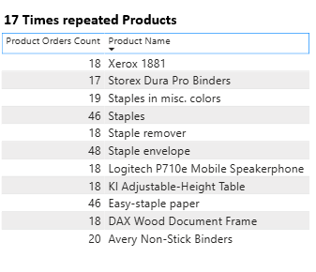
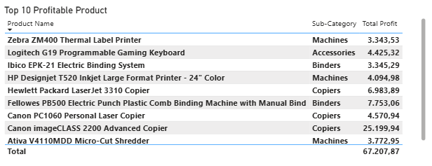
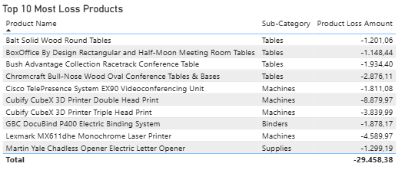

Slide 9
Product Performance & Profitability Overview
This page provides a comprehensive view of product performance, demand consistency, and profitability across the Superstore portfolio.
Out of 1,862 total products, a clear demand concentration is visible. A subset of products is repeatedly ordered, indicating strong and consistent customer demand. The interactive Repeated Products control highlights items ordered multiple times, helping identify core, high-velocity products that drive recurring revenue.
The Top 10 Most Selling Products represent the primary sales contributors, dominated by office equipment and technology categories, while the Top 10 Profitable Products reveal that high revenue does not always equate to high profit—profitability is driven by a mix of pricing, cost structure, and repeat demand.
At the same time, the loss-making products section exposes underperforming items generating negative margins. These products highlight opportunities for pricing optimization, cost reduction, supplier renegotiation, or portfolio rationalization.
Overall, this analysis enables data-driven decisions to:
Prioritize high-demand and high-profit products
Reduce exposure to loss-making items
Strengthen inventory planning based on repeat purchase behavior
Align product strategy with profitability, not just sales volume
This page supports strategic actions aimed at sustainable growth, margin improvement, and operational efficiency.

Slide 10
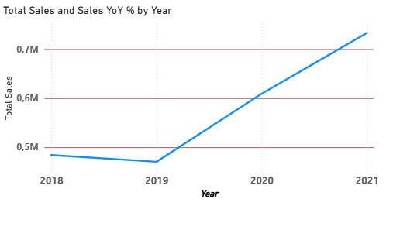
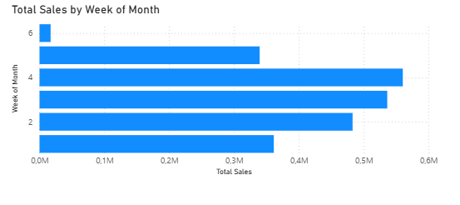
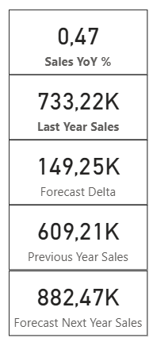
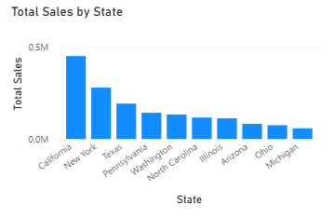
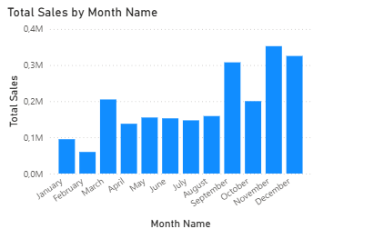
Time and regional Analysis and Business forcast

Slide 11
Time & Regional Performance Analysis
This section analyzes sales performance across time dimensions (year, quarter, month, and day) and geographic regions to identify growth patterns, seasonality, and regional strengths.
Sales show a consistent upward trend year over year, with strong acceleration in the most recent year, indicating healthy business growth. Monthly analysis reveals clear seasonality, with peak performance during the later months of the year, supporting demand planning and inventory optimization. Day-level patterns further highlight specific weekdays with higher sales activity, enabling better staffing and operational planning.
From a regional perspective, revenue is unevenly distributed, with the West and East regions leading total sales, while Central and South regions show moderate but stable contributions. State-level insights identify top-performing markets and underpenetrated regions, creating opportunities for targeted regional strategies and localized marketing initiatives.
Overall, this analysis helps the business understand when and where sales are generated, enabling more accurate forecasting, regional prioritization, and time-based decision-making.
Business Forecast & Growth Outlook
The business forecast projects next-year sales based on historical performance and year-over-year growth trends.
Using the latest completed year as a baseline, the forecast indicates a strong positive growth trajectory, with expected sales increasing significantly in the upcoming year. The forecast delta highlights incremental revenue potential, validating the effectiveness of current sales momentum and customer retention strategies.
This forward-looking view enables stakeholders to:
Set realistic revenue targets
Plan capacity, inventory, and staffing
Align marketing and regional expansion strategies
Identify early signals of growth acceleration or slowdown
Overall, the forecast confirms that the business is positioned for continued expansion, provided current performance trends and operational efficiency are maintained.

Slide 12
Business Storytelling (Executive Narrative)
This project provides a comprehensive analysis of Superstore’s sales performance over four years. The analysis reveals a temporary slowdown in 2019 followed by a strong recovery and consistent growth in 2020 and 2021.
Key observations include:
Clear seasonality, with peak sales occurring in Q4 (September–December)
Strong regional concentration, where West and East regions contribute the highest share of revenue
High customer retention, with repeat customers forming the majority of the customer base
Product performance imbalance, where a subset of products consistently generates losses despite sales volume
Using the most recent year-over-year growth trend, a forward-looking sales forecast was developed to support planning and budgeting decisions.

Slide 13
Final Conclusion:
The analysis demonstrates that Superstore has a scalable and growth-oriented business model, supported by strong customer retention and regional performance.
However, the presence of loss-making products highlights the need for:
Product portfolio optimization
Pricing and discount strategy review
Region-specific performance management
With targeted improvements, Superstore has the potential to outperform the projected forecast and achieve sustainable long-term growth.

